Slide 1
Fire Accident Image Processing and Classification from UAV using AI for Forest Fire
Mentor: Dr. Madiah Omar, UTP
Co-Mentor: Dr. Eakalak Khan, UNLV
Graduate Mentor: Sayeda Ummeh Masrura, UNLV
Wan Muhammad Haikal Wan Mohd Nadzri, UTP
Jake Minh Luu, TAMU
Mariana Gomez, NC A&T State
Steven Le, UNLV
Notes:
Add the logo UTP, UNLV,NCAT,TAMU,NSF

Slide 2
Background
Fires can happen at any time in any forest.
Difficult for firefighters to patrol large and inaccessible areas.
A solution is access by air, using Unmanned Aerial Vehicle (UAV).
UAV with machine learning capabilities (ex: Artificial Intelligence) can patrol large areas, identify fires, and communicate relevant information.
UAV captures footage of forest fire.
Using a fire segmentation method that is based on color distribution to filter the image campute by UAV.
YOLOv3 algorithm quickly and accurately classifies and identifies fire(s) in the captured footage.
The UAV reports the forest fire(s) back to headquarters so that the proper authorities can be contacted and control the fire before it spreads too far.

Slide 3
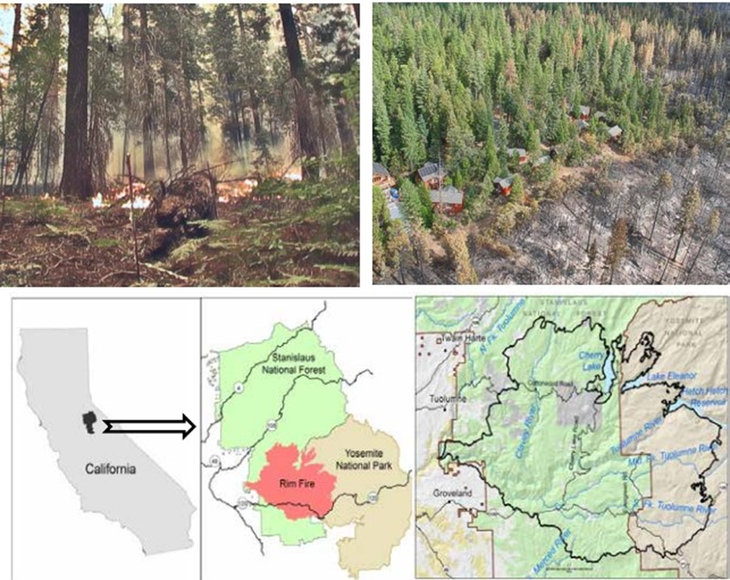
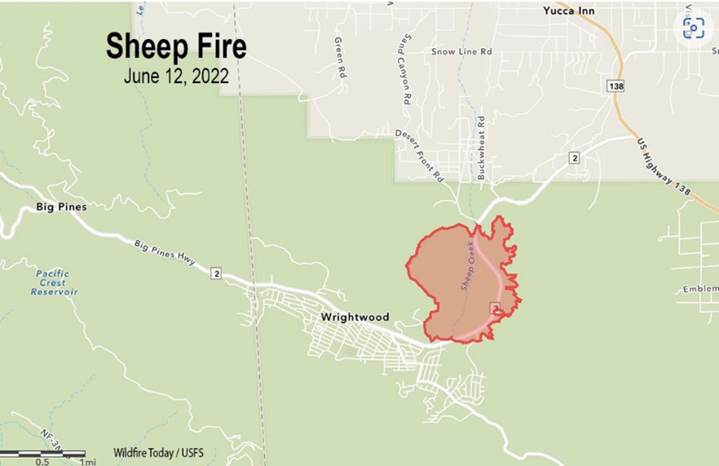
Fires
Rim fire (2013)
Sierra nevada, CA
257,314 acres
Burned hundreds of acres in Yosemite National Park
The fire gives opportunity to restore the forest in a natural way
8th biggest fire in the state of CA(2020)
Sheep fire
865 acres
Wrightwood CA
2013 Rim Fire Fuel Treatment Effectiveness Summary (pubcom.com) USDA
Sheep Fire Archives - Wildfire Today

Slide 4
Objective(s)
To select forest fire occurrence data that most accurately depicts specific forest fires in high resolution footage.
To prepare the dataset by applying preprocess method of fire segmentation before using them to train and test the YOLOv3 algorithm in order to improve the accuracy of the model.
To incorporate and developing the YOLOv3 Algorithm model to enable the detection and recognition of forest fires during the initial stage.
Notes:
To investigate fire incidence
To reprocess the dat
To develop the algorithm

Slide 5
Expected Outcome/Potential Benefits of the Study
The results of this model will be helpful in lowering the frequency of fire accidents.
It will be an essential component in creating a fire protection system and can be used for early fire warnings.
Early detection of forest fires could save billions of dollars, hundreds of human and wild lives, and communities(structures).

Slide 6
Methodology
Research forest fire footage
Data Pre-Processing
Fire Training/Testing
Research forest fire and weather conditions before ignition.
Find Tick fire footage.
Collect images from Tick fire accident video.
Dataset goes through fire segmentation algorithm.
Final images are ready for training and testing.
Segmented fire dataset split into 70/30.
70 portion is classified and to be trained under the YOLOv3 algorithm.
Remaining 30 portion will be used for testing for model accuracy.

Slide 7
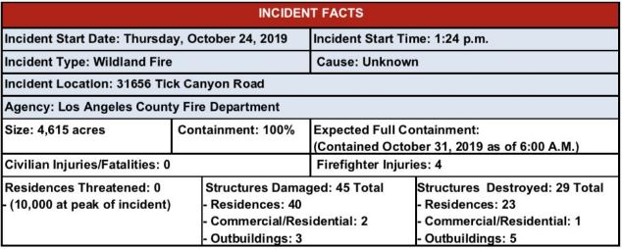
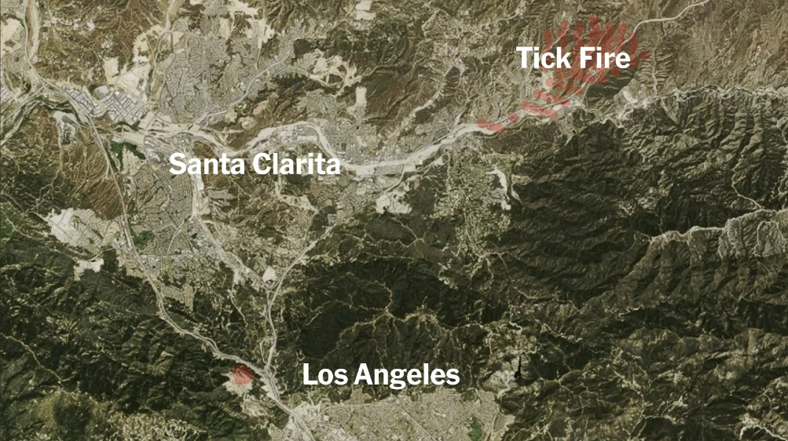
Tick fire
Footage
Able to find aerial view of the fire.
Including reduce amount of smoke, presence of red flames, existence of burning vegetation.
Humidity hovering around 6%.
Wind gusts of up to 29 mph.
Temperature 92 F
tick fire map - Bing images
#TickFire - Twitter Search / Twitter L.A COUNTY FIRE DEPARTMENT

Slide 8
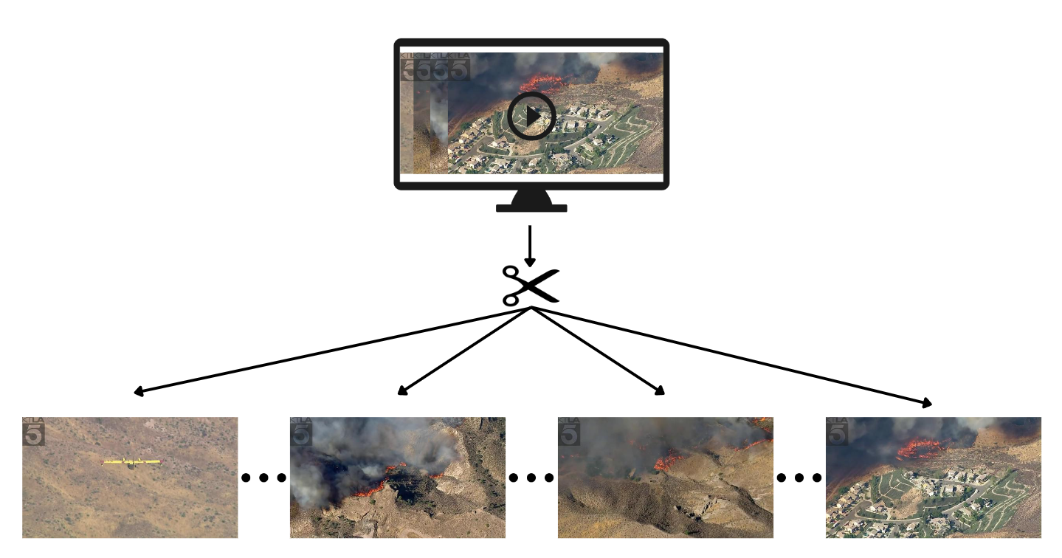
Data Collection
Tick Fire Explodes in Agua Dulce Area
Cut a frame every second
1364 fire images
131 non-fire images
Video Source: KTLA 5

Slide 9
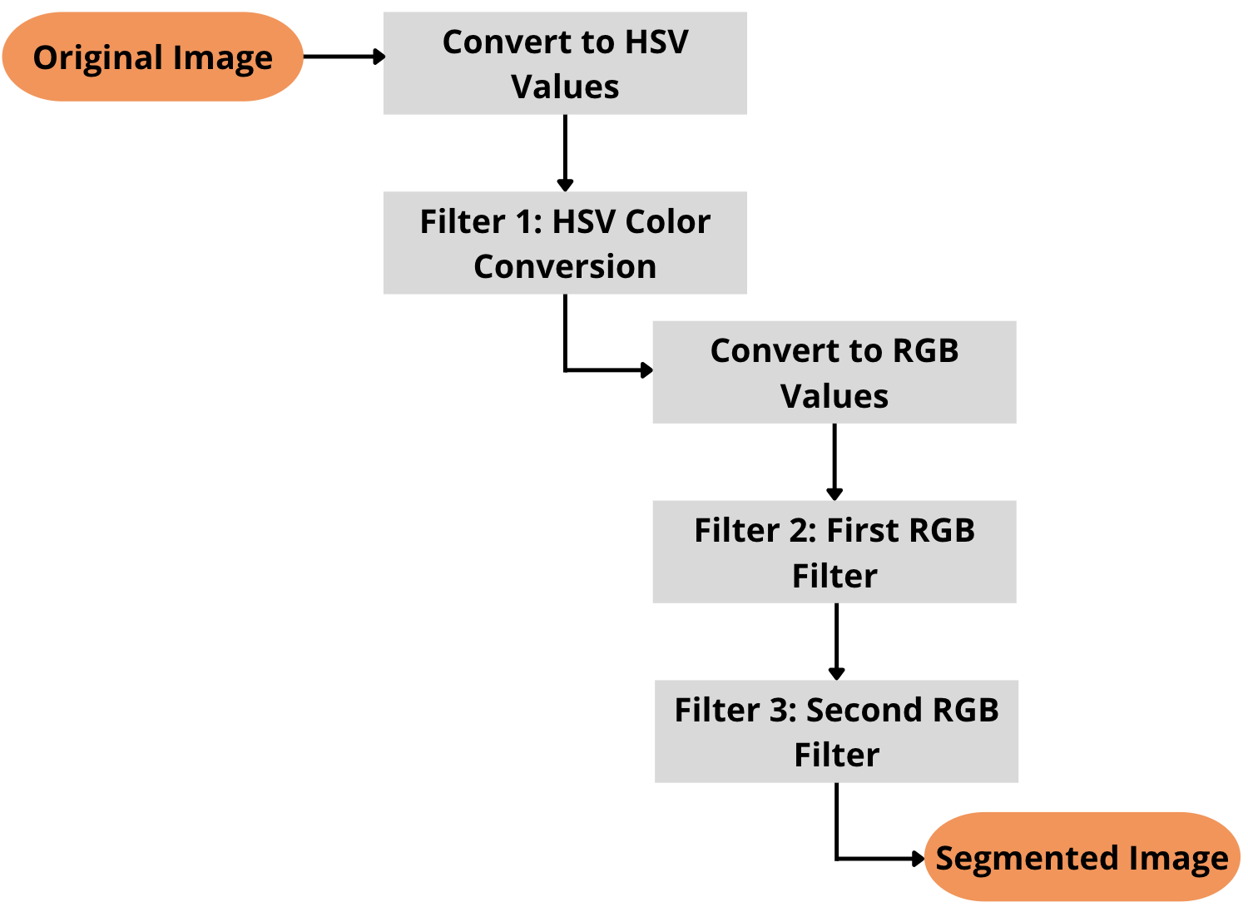
Data Pre-Processing
Flow diagram of fire segmentation algorithm
Utilizes two color spaces:
Hue, Saturation, Value (HSV)
Red, Green, Blue (RGB)

Slide 10
Filter 1: HSV Color Conversion
Captures the whole color range of the fire
Leaves undesired non-fire pixels

Slide 11
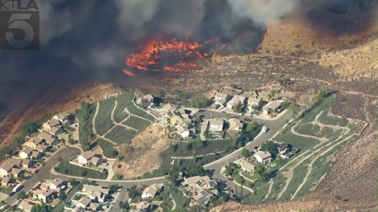
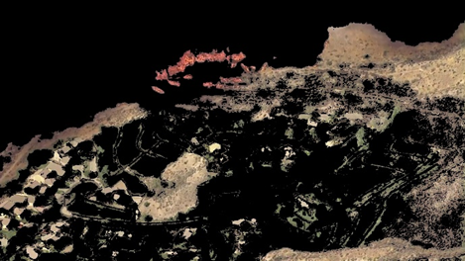
After Filter 1

Slide 12
Filter 2: First RGB Filter
Check whether a pixel has a greater G-channel than R-Channel.
If yes, set every channels in that pixel to 0 (black).
If no, go to the next pixel.

Slide 13
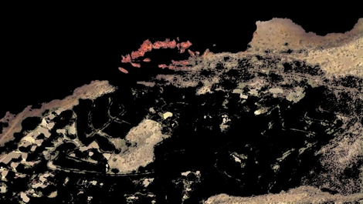
After Filter 2

Slide 14
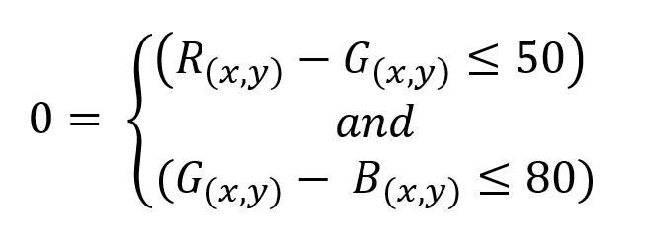
Filter 3: Second RGB Filter
Check differences between R-channel and G-channel and G-channel and B-channel
If yes for both conditions, set every channels in that pixel to 0 (black).
If no, go to the next pixel.

Slide 15
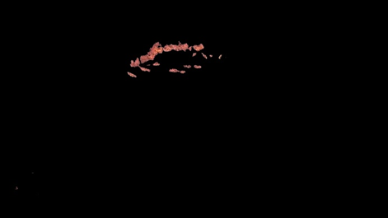
After Filter 3

Slide 16
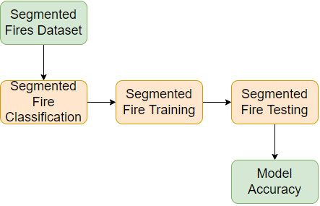
YOLOv3 Algorithm
Uses deep convolutional neural network.
Fast algorithm speeds
Scores the image regions to predefined classes based on their similarities
Notes:
Increase the font size and diagram size
Acknowledge the source of images

Slide 17
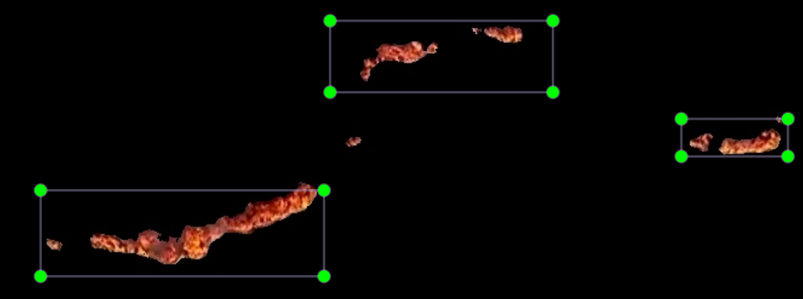
Fire Classification
Selected coordinates of the key features will be focused on during training.
Selected coordinates was done for 956 images for the training dataset.

Slide 18
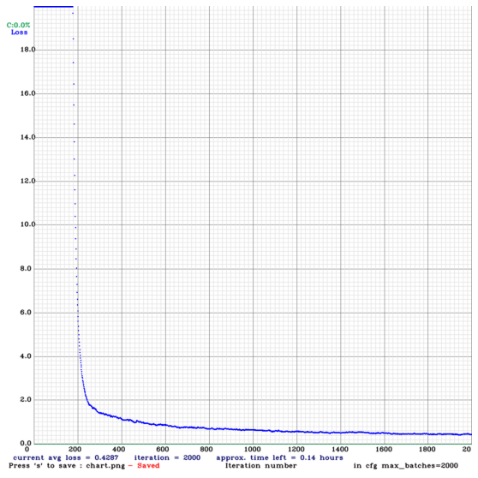
Fire Training
Training is done from a free online source on Google Colab
Training will go through 2000 iterations of each image
y= Loss
x= Iterations

Slide 19
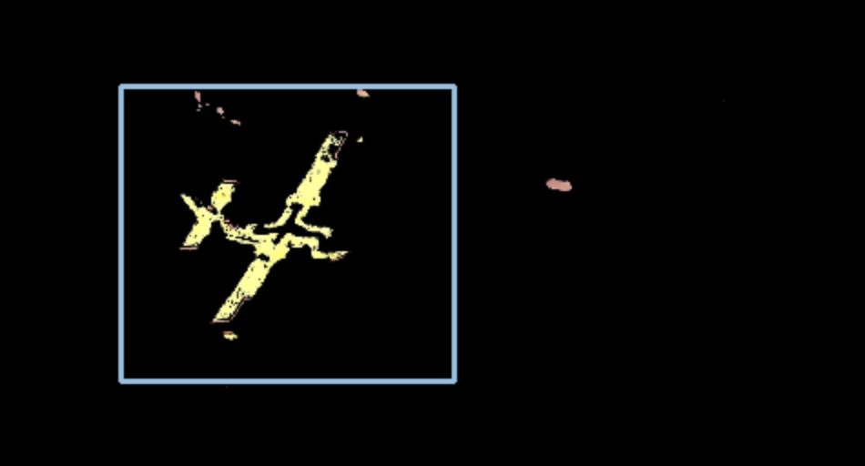
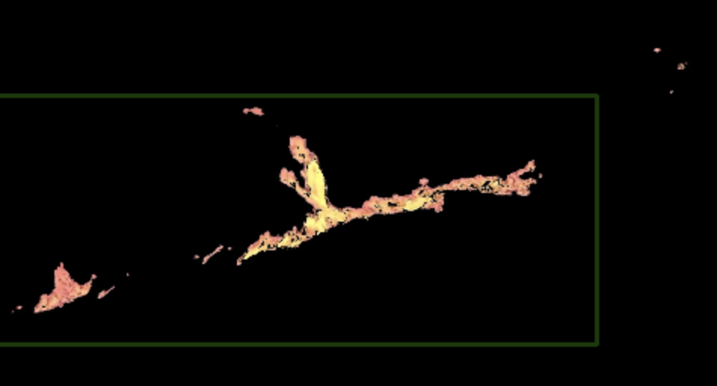
Fire Testing
After training, the model goes through testing to measure the accuracy of the model.
Amount of images of the testing dataset is 530.
Accuracy formula.
False Negative
False Positive
True Negative
True Positive

Slide 20
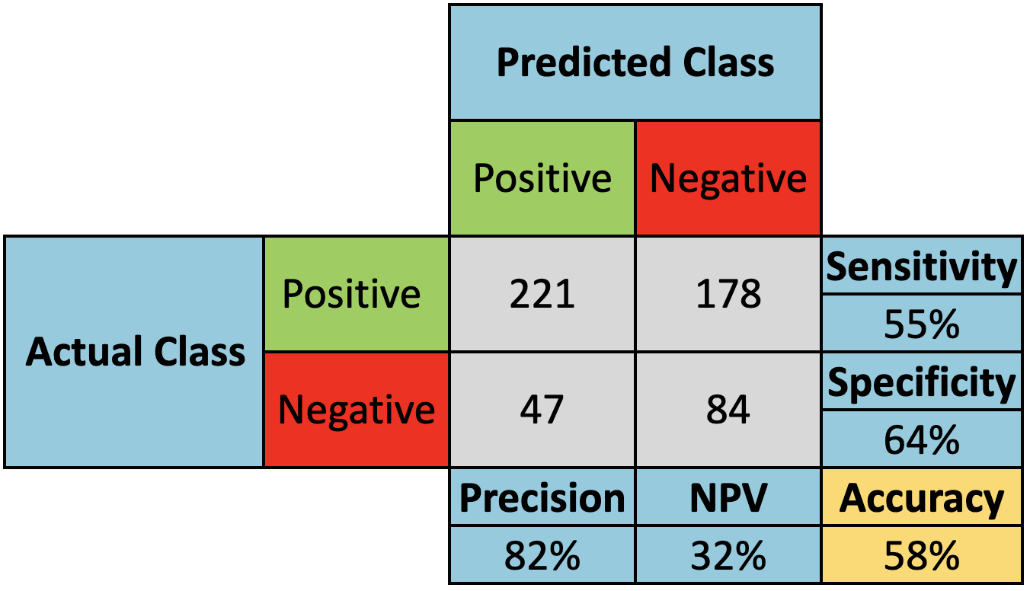
Model Results
The model is projected to be 58% accurate
221 true positive
47 false positive
178 false negative
84 true negative

Slide 21
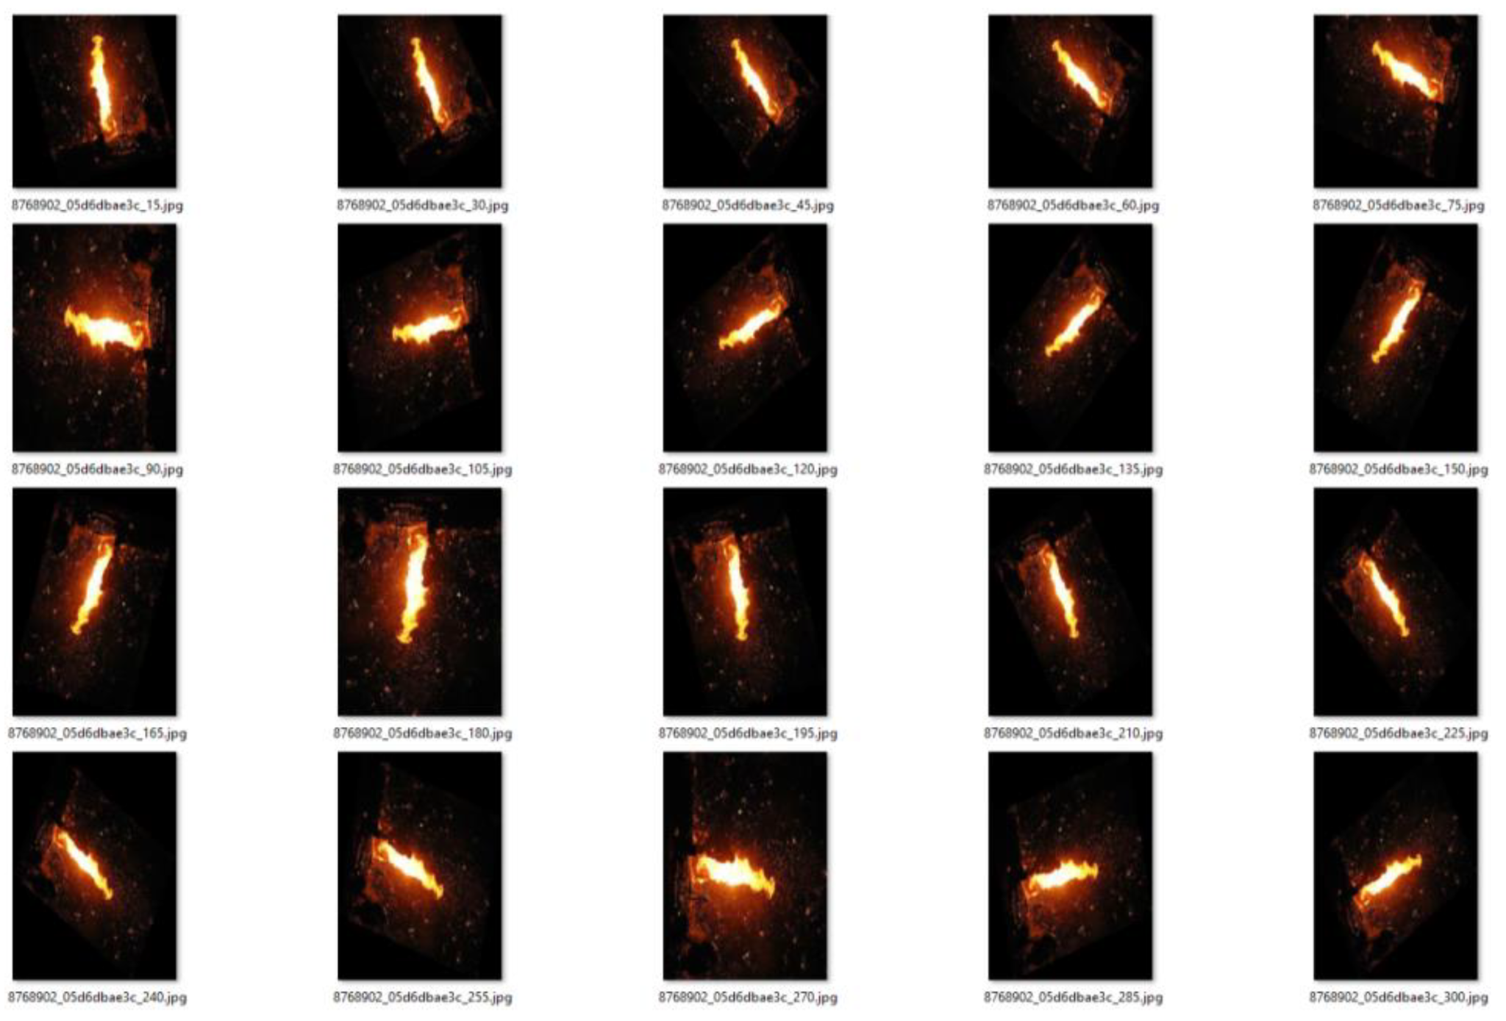
Model Improvement
Methods of improvement
Dataset Augmentation
Test Time Augmentation
Fire Augmentation

Slide 22
Conclusion
The lack of quality, aerial footage makes it difficult to train the AI(YOLOv3) effectively.
The fire segmentation method has its flaw when either smoke is hazing the fire or most of the image is in red, orange, or yellow.
The YOLOv3 model has inconsistencies when training and testing with the given dataset.

Slide 23
Recommendations
Allow footage from more than one forest fire.
Color correction of images before segmenting the fire.
Train the model with a larger dataset that has more dominant features.

Slide 24
Acknowledgements
This work was supported by the National Science Foundation’s International Experience for Students (IRES) Site grant. (Grant Numbers: OISE# 1952490-TAMU, 2208801-NC A&T State, and 195249-UNLV). Any opinions, findings, conclusions, or recommendations presented are those of the authors and do not necessarily reflect the views of the National Science Foundation.
Thank you to the Universiti Teknologi PETRONAS and their Student Mobility office for welcoming and hosting the students during their stay in Malaysia.

Slide 25
THANK YOU

Slide 26
QUESTIONS

