Slide 1
IRES Project 3: Prescriptive Maintenance Model using Deep Learning: A Remaining Useful Life Prediction applied to Turbofan Engine
By: William Teasley, Brad Medlock, & Giovanni Jimenez

Slide 2
Scope of the Project
We look to establish a model to accurately predict RUL data based upon sensor diagnostics from aircraft engines
As accurate predictions are made based off the model, the maintenance to each engine can be established with increased confidence
Practical use of this model, outside of the scope of this project, allows for more conclusive maintenance tactics, such as prescriptive, to be established long term
Utilized the Commercial Modular Aero-Propulsion System Simulation (C-MAPSS) data to establish model

Slide 3
Introductory Information and Keywords

Slide 4
Introduction: Remaining Useful Life (RUL)
Length of time an item is likely to operate satisfactorily before it needs to be repaired or replaced
Schedule maintenance (Predictive Maintenance)
Optimize efficiency
Avoid unplanned downtime

Slide 5
Introduction: Equipment Maintenance

Slide 6
Equipment Maintenance
Condition-based maintenance process that uses data analytics to indicate possible equipment failure time for scheduling maintenance
Can help identify causes for failure
Main goal is to boost and preserve quality and productivity by reducing unplanned downtime, sudden equipment failure, & maintenance cost

Slide 7
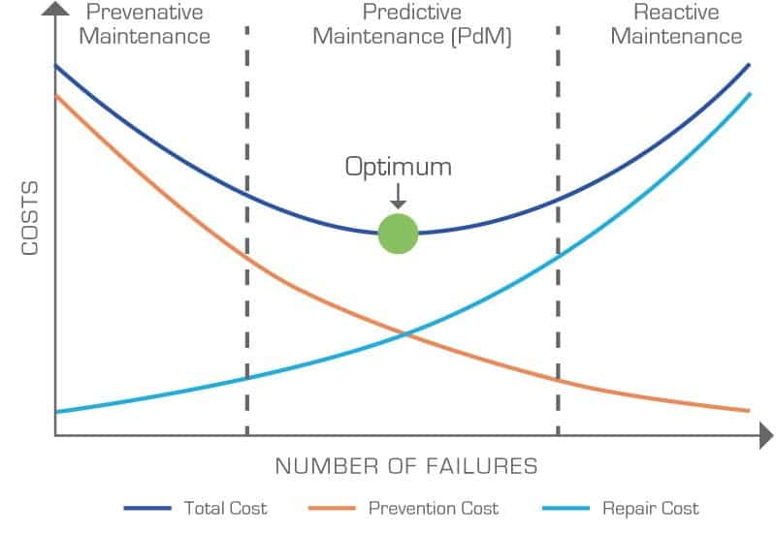
Maintenance Models
The three current models that are commonly used in equipment maintenance are
Reactive
Preventative
Predictive
Introduction: Equipment Maintenance

Slide 8
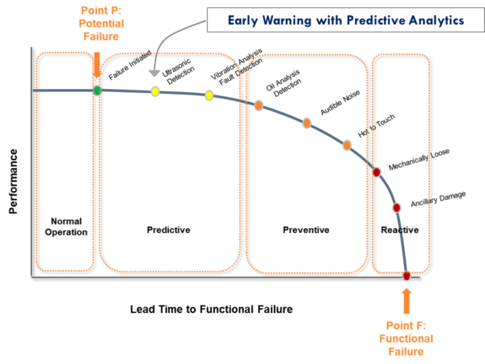
Relevance to RUL analysis

Slide 9
Introduction: Deep Learning
Deep Learning is a type of machine learning, where the model learns from multiple sets of data.
The model will recognize patterns across data sets, and use information learned from them to make predictions.
Deep Learning requires large amounts of data to be accurate enough to make predictions.
Most deep learning models utilize neural networks.
Deep Learning also operates through trial and error, using the incorrect predictions to further improve the model.

Slide 10
Introduction: Convolution Neural Networks (CNN)
A class of deep neural networks that utilizes numerical functions to reduce complex network information into more manageable pieces that allows for the computer to more accurately and efficiently come to a correct conclusion
In the context of this project,

Slide 11
Literature Review
Author | Year | Algorithm/Technique Used | Dataset | Results Achieved | Limitations/Gaps
Ji et al., | 2021 | Data Driven Fault Diagnostics and Remaining Useful Life predictions using Machine Learning and Machine Statistics | - | - | Fault data is collected under normal circumstances, lacks extreme circumstances
Wang et al., | 2019 | -DL Analysis as opposed to strictly Physical or Data or Hybrid based approaches | - | - | "Run-to-fail" Data is required
 |  | -RNN, AE, DBN, CNN
Yao et al., | - | Deep Q Transfer Learning (DQTL) | Q- Function acquired from Kistler compact multicomponent dynamometer and DAQ Elsys TraNET 404s8 | RMSE=20.23 min MAE=16.54 | Extensive noise reduction methods needed to accommodate for extreme deformations
Nemetha et al. | 2018 | PriMa-X Boost in PSM | - |  | Functionality of PriMa-X Boost in PSM

Slide 12
Literature Review continued
Author | Year | Algorithm/Technique Used | Dataset | Results Achieved | Limitations/Gaps
WANG et al., | 2021 | DCNN, LSTM... | Random variable | DCNN RMSE: 1.986 - LSTM RSME: 0.25425/ MAPE:14.785 | a multitude of of algorithms are needed to obtain specific results such as speed and accuracy
Sayyad et al., | 2021 | Data-driven and multiple decision making algorithms (SVM, ANN, AE...) | NASA milling data set, PHM 2010 | multiple solutions | Data captured by sensors leave room for a significant amount of noise. Low Accuracy
Alam et al., | 2021 | Sequential event data. 1D-CNN/ LSTM/ Multi-head attention/ XGboost | C-MAPSS | Multiple results. All except XGboost achieved similar RSME values | event data contains challenges such as absence of specific patterns, lack of periodicity, and random nature of "event appearance."

Slide 13
Methodology
Since Deep Learning requires data sets in order to learn, sensor data was taken from several engines at specific areas of the engines.
This data measured the quality of the given parts over an extended period of time.
This was then compared with overall RUL of the engine.
This will then allow us to see what parts of the engine have a greater significance in overall RUL.
The code used to cluster and analyze the data was written in Python and MatLab.
Graphs were made of data from specific sensors in order to visualize the data. The graphs overlaps all trial readings in a case study.

Slide 14
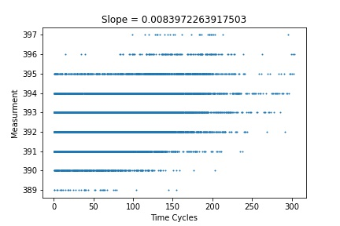
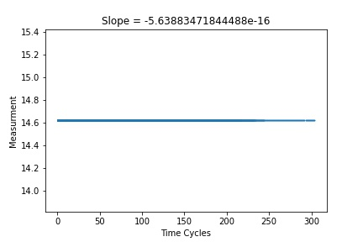
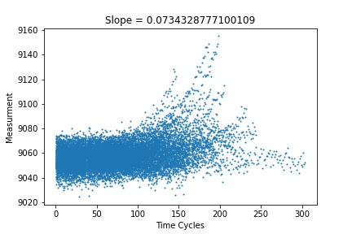
Methodology
Oper. Sensor 17.
While the slope is positive, readings only exist at specific intervals. Meaning that the lack of precision make it difficult to properly discern the importance of this data set.
Oper. Sensor 9.
One of the more telling graphs, we can see that this part suffers more from wear and tear over time, having one the more impactful aspects on overall RUL.
Oper. Sensor 5.
All data for the trials show essentially the exact same reading. While a slope was calculated, it is so near-zero that sensors with this type of output can be disregarded in predicting overall RUL.

Slide 15
Methodology
After deriving the importance each engine area has on overall RUL, the model can begin using Deep Learning to learn from the recorded data.
The type of training we we used in our deep learning is a Convolution Neural Network (CNN)
The model will ignore unimportant data, and recognize changes in the important ones. This is known as feature selection.
This is where the fact that using CNN is helpful, because CNN learning adaptively uses hierarchies of data importance in order to better discern the best way to effectively predict RUL.
Feature selection through CNN was paramount in our final model.

Slide 16
Methodology
CNN layering came into play as was scene in the graphs.
The layering creates more distinct patterns across all cases for each sensor reading data, giving the most effective
The model should then be able to recognize similar patterns in future readings, and having learned from the fed data, will be able to predict when a fail state is imminent.
Should the model detect an upcoming fail state in the engine, it will alert the user.
Convolution Layer Formula
Pooling Layer Formula

Slide 17
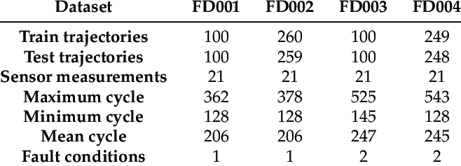
Results
Commercial Modular Aero-Propulsion System Simulation, C-MAPPS data set created by NASA
A simulation of realistic large commercial turbofan engine data

Slide 18
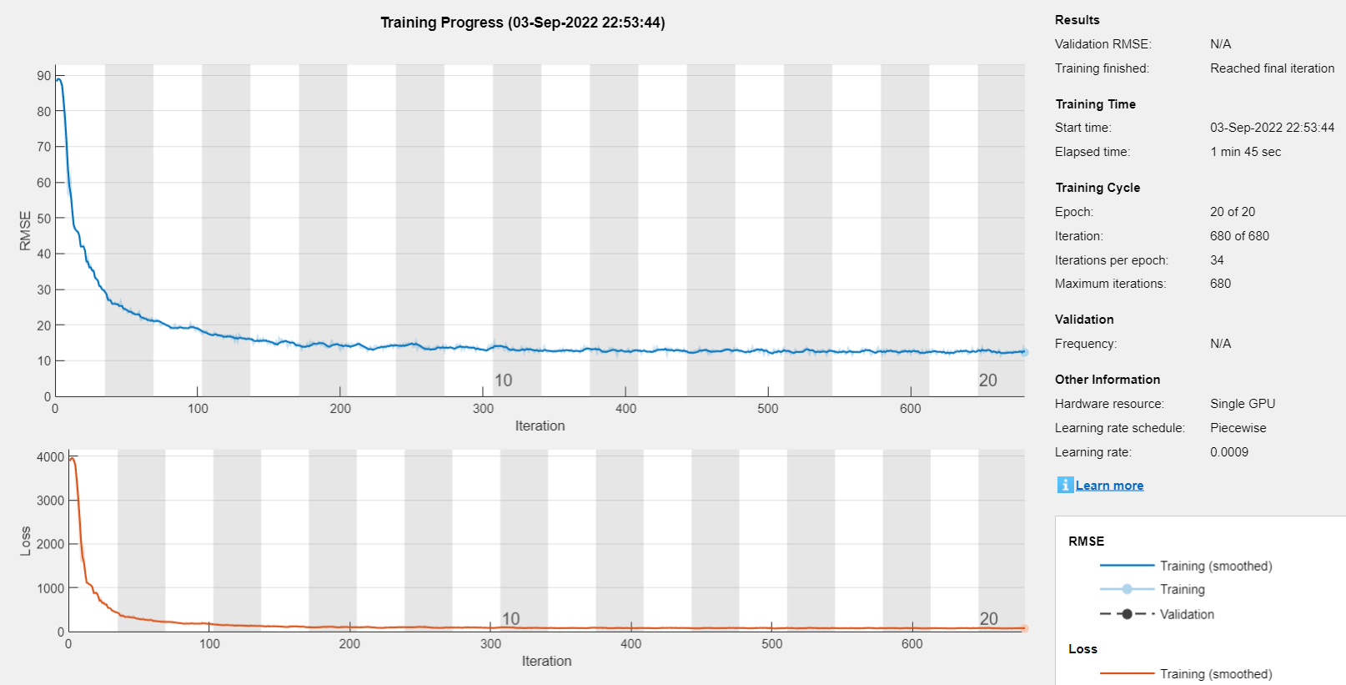
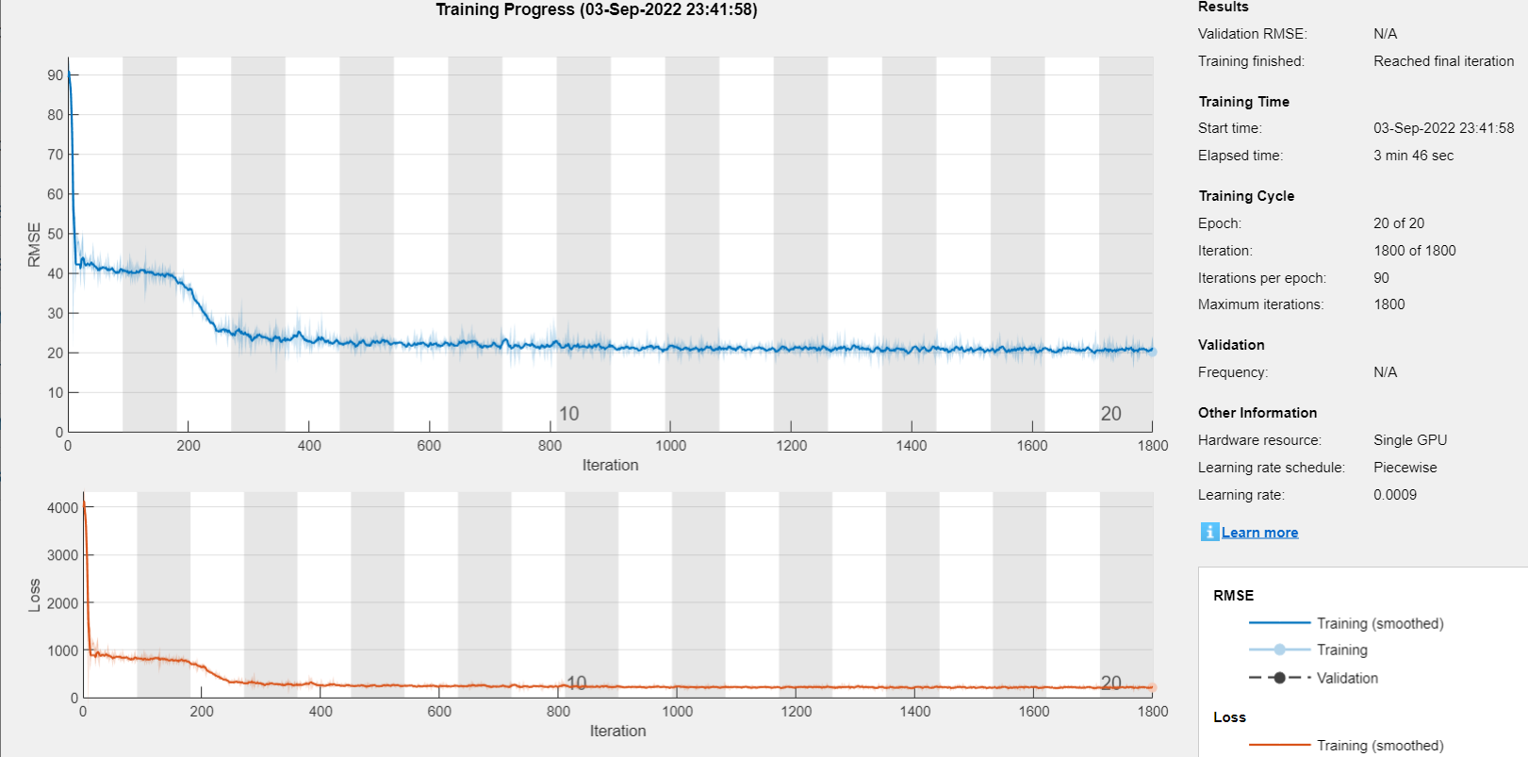
Training for FD001
Training for FD002
Complexity between the training can be seen
The amount of time taken
The amount of iterations

Slide 19
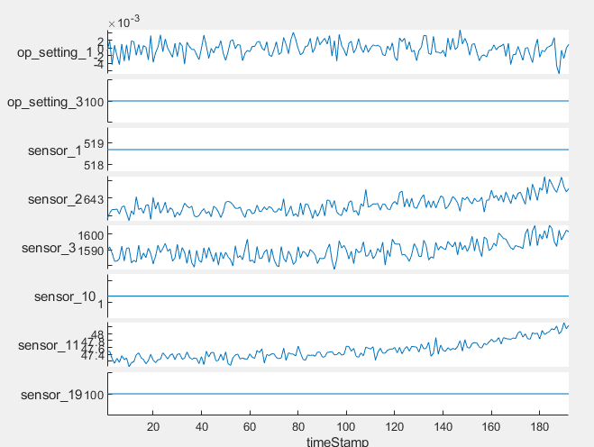
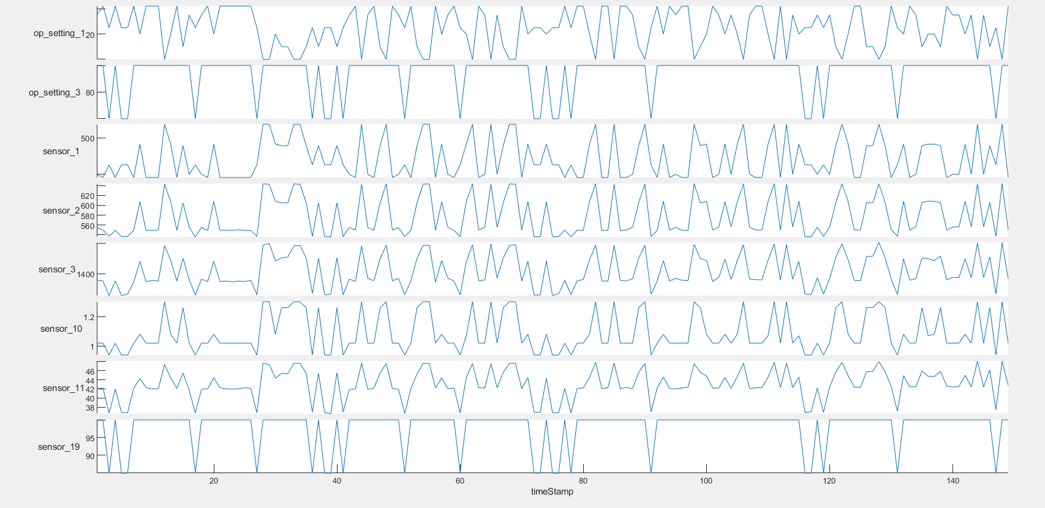
FD001 Sensors
FD002 Sensors
Slope of a straight line indicates unuseful data/features
Sensors in case 1 are much more simple compared to case 2

Slide 20
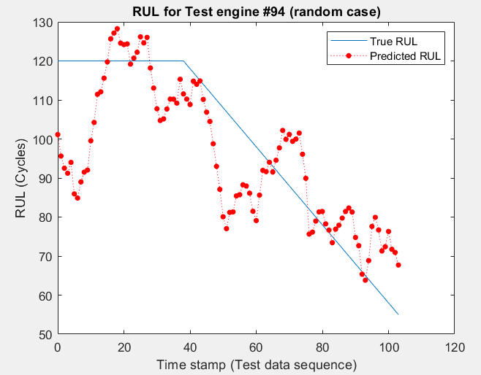
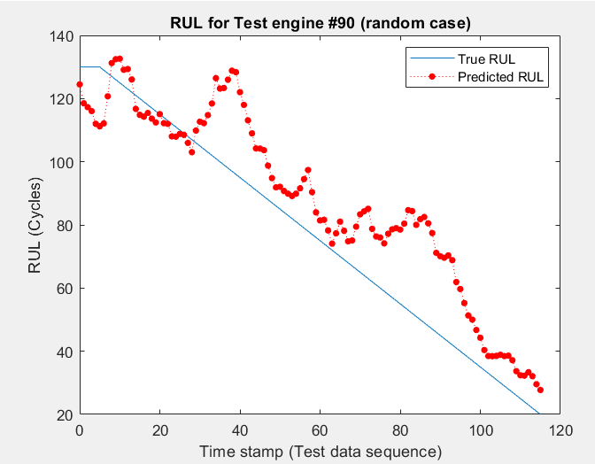
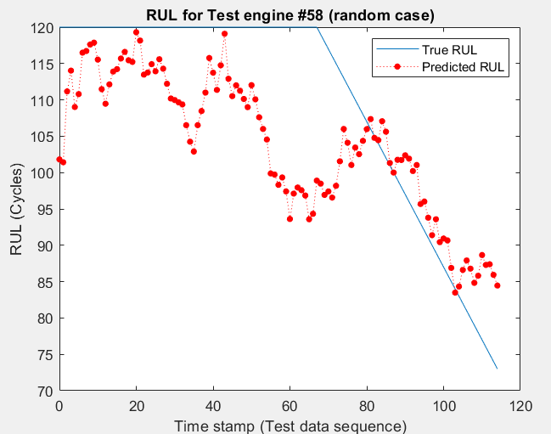
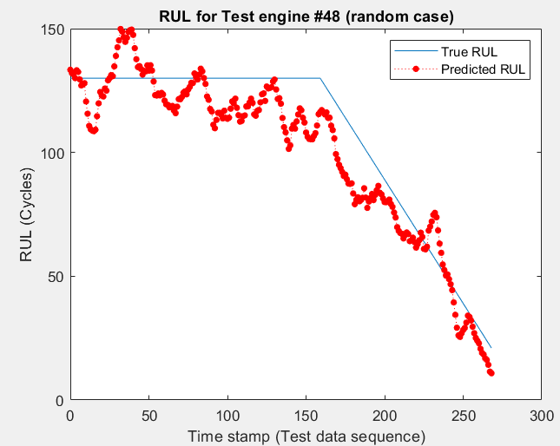
FD001
FD003
FD002
FD004

Slide 21
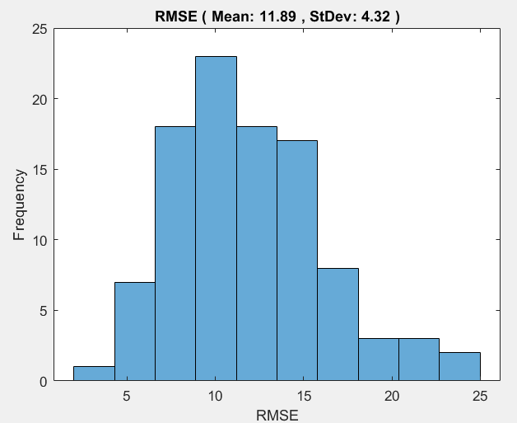
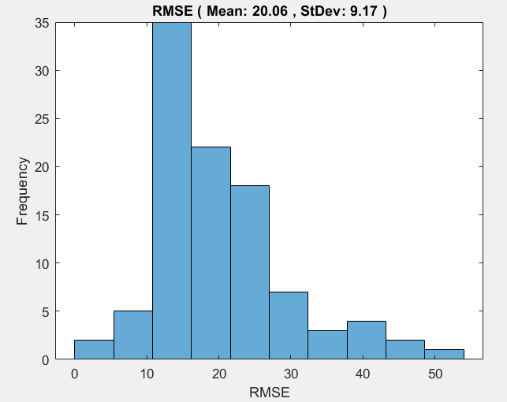
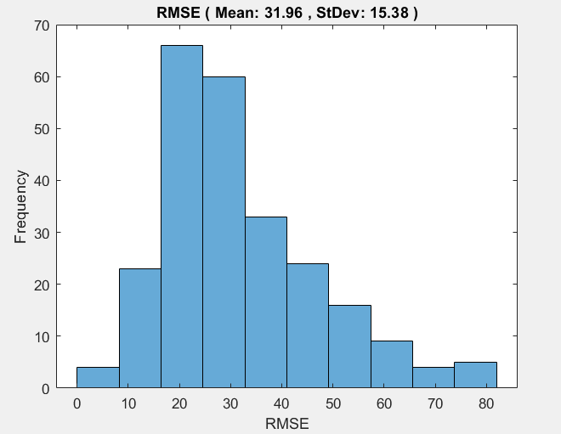
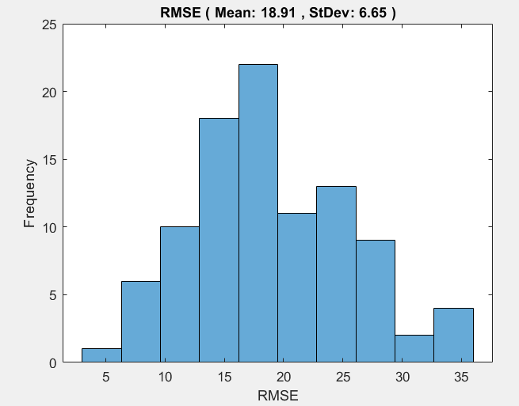
FD001
FD003
FD002
FD004

Slide 22
Conclusion
The use of Deep Learning and Predictive maintenance will help prevent unexpected damages, saving operators money in maintenance and repair costs.
With this in mind, a high degree of accuracy is needed when predicting RUL
When introduced to more complex datasets, our models accuracy of predicting RUL starts to fall short, as shown with the RMSE results
The model is in the right direction, but more work needs to be done

Slide 23
Limitations & Future work
Time frame
Upgrading the model so that it incorporates reinforced learning instead of deep learning
CNN model needs further tuning and hyperparameter optimizations
Can be done by implementing it with Bayesian or metaheuristic optimization algorithm to enhance model performance

Slide 24
References
Alam, M., Jalali, L., Alam, M., Farahat, A., & Gupta, C. (2021). Remaining useful life estimation from event data. Annual Conference of the PHM Society, 13(1). https://doi.org/10.36001/phmconf.2021.v13i1.3055
Amunategui, M. (n.d.). NASA IOT - Different Ways to model predictive maintenance and engine degradation. The ViralML Show! NASA IoT - Different Ways to Model Predictive Maintenance and Engine Degradation. Retrieved July 19, 2022, from https://www.viralml.com/video-content.html?v=4GBO2GNmEzk&Title=NASA+IoT+-+Different+Ways+to+Model+Predictive+Maintenance+and+Engine+Degradation
Liu, Y. &amp; Liu, X.. (2021). CTS2: Time Series Smoothing with Constrained Reinforcement Learning. <i>Proceedings of The 13th Asian Conference on Machine Learning</i>, in <i>Proceedings of Machine Learning Research</i> 157:363-378 Available from https://proceedings.mlr.press/v157/liu21b.html.

Slide 25
References (cont.)
Makinarocks. (n.d.). Awesome-industrial-machine-datasets/readme.md at master · Makinarocks/awesome-industrial-machine-datasets. GitHub. Retrieved July 19, 2022, from https://github.com/makinarocks/awesome-industrial-machine-datasets/blob/master/data-explanation/C-MAPSS/README.md
Nemeth, T., Ansari, F., Sihn, W., Haslhofer, B., & Schindler, A. (2018). Prima-X: A reference model for realizing prescriptive maintenance and assessing its maturity, enhanced by machine learning. Procedia CIRP, 72, 1039–1044. https://doi.org/10.1016/j.procir.2018.03.280
Sayyad, S., Kumar, S., Bongale, A., Kamat, P., Patil, S., & Kotecha, K. (2021). Data-driven remaining useful life estimation for milling process: Sensors, algorithms, datasets, and Future Directions. IEEE Access, 9, 110255–110286. https://doi.org/10.1109/access.2021.3101284
Wang, Q., Zheng, S., Farahat, A., Serita, S., & Gupta, C. (2019). Remaining useful life estimation using functional data analysis. 2019 IEEE International Conference on Prognostics and Health Management (ICPHM). https://doi.org/10.1109/icphm.2019.8819420

Slide 26
References (cont.)
Brownlee, Jason. “Introduction to Dimensionality Reduction for Machine Learning.” Machine Learning Mastery, 30 June 2020, https://machinelearningmastery.com/dimensionality-reduction-for-machine-learning/#:~:text=Dimensionality%20reduction%20refers%20to%20techniques%20for%20reducing%20the%20number%20o.
Kumbhare, Trupti A., and S. Chobe. “[PDF] an Overview of Association Rule Mining Algorithms: Semantic Scholar.” An Overview of Association Rule Mining Algorithms, International Journal of Computer Science and Information Technologies, 1 Jan. 1970, https://www.semanticscholar.org/paper/An-Overview-of-Association-Rule-Mining-Algorithms-Kumbhare-Chobe/d4058d9f3f66c53ddea776c974fbd740afd994b4.
Madhulatha, T. Soni. “An Overview on Clustering Methods.” IOSR Journal of Engineering, vol. 02, no. 04, 5 May 2012, pp. 719–725., https://doi.org/10.9790/3021-0204719725.
Tian, Y., Han, M., Kulkarni, C., & Fink, O. (2022, April 30). A prescriptive Dirichlet power allocation policy with deep reinforcement learning. Retrieved July 25, 2022, from https://www.sciencedirect.com/science/article/pii/S0951832022001831

Slide 27
Acknowledgements
This work was supported by the National Science Foundation’s International Experience for Students (IRES) Site grant. (Grant Numbers: OISE# 1952490-TAMU, 2208801-NC A&T State, and 195249-UNLV). Any opinions, findings, conclusions, or recommendations presented are those of the authors and do not necessarily reflect the views of the National Science Foundation.

